Slide 1
Banking SYSTEM
Gaurav Galiyawala

Slide 2
AGENDA
Introduction
Technologies
Understanding UCD
Under Standing Flow
Project Description
Summary

Slide 3
INTRODUCTION
Banking System in Python. This Project combines the power of a sleek user interface and MongoDB for robust data management. Provides all necessary things required for banking. Let’s understand more!

Slide 4
Technology stack
Python: Chosen for versatility and ease of use.
Tkinter: Used to create GUI, ensuring ease of use.
MongoDB: Selected as the database to store user data securely.
SHA256: Used for hashing, ensuring password security.

Slide 5
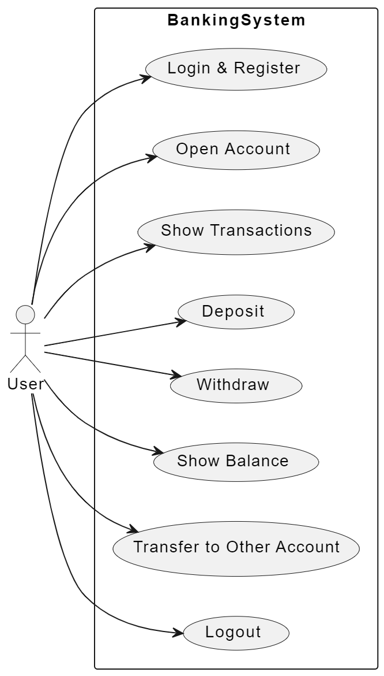
Use Case Diagram(UCD)

Slide 6
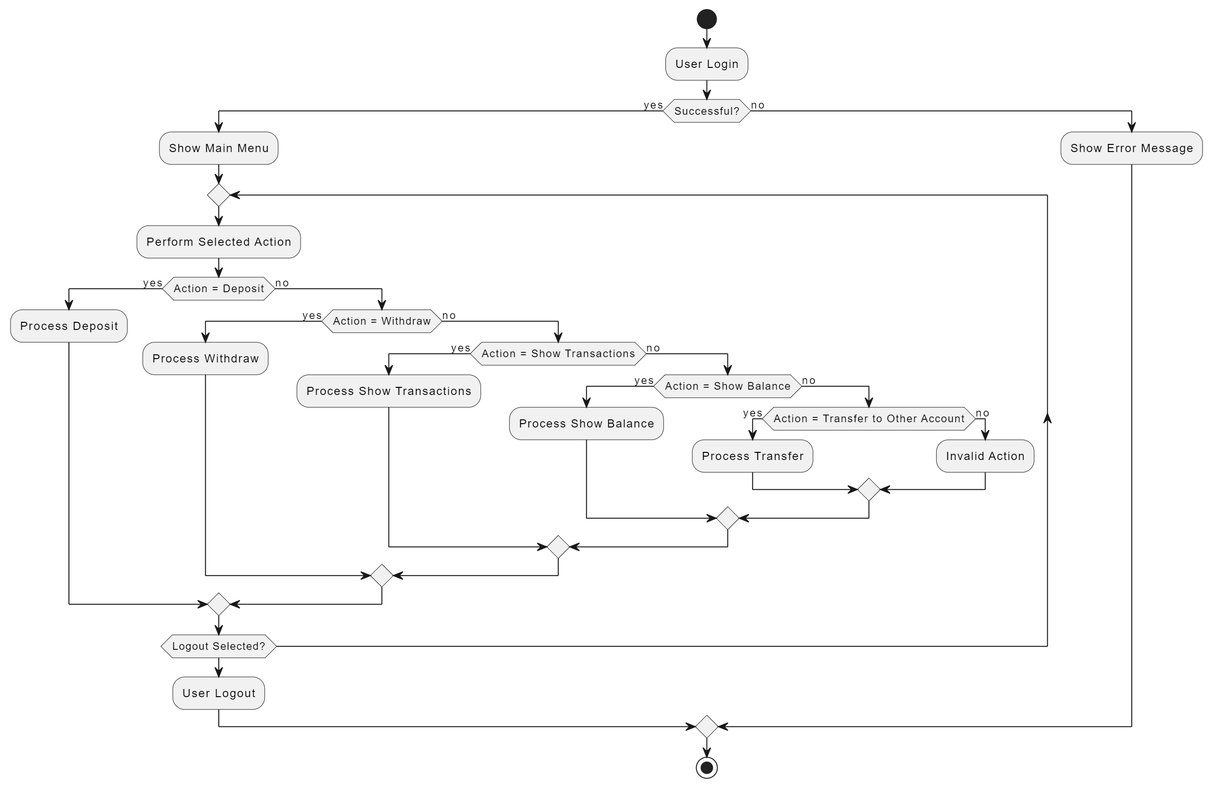
FLOW DIAGRAM

Slide 7
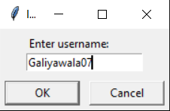
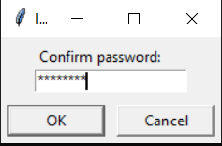
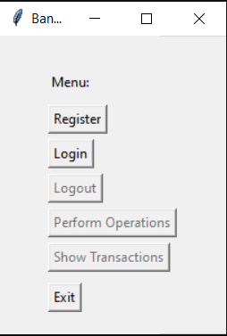
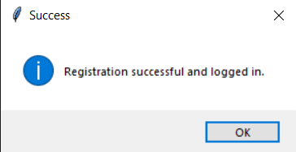
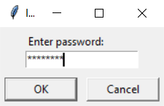
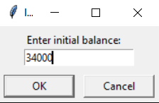
Project DescRiption
Registration 1
Registration 3
Registration 5
Home
Registration 2
Registration 4

Slide 8
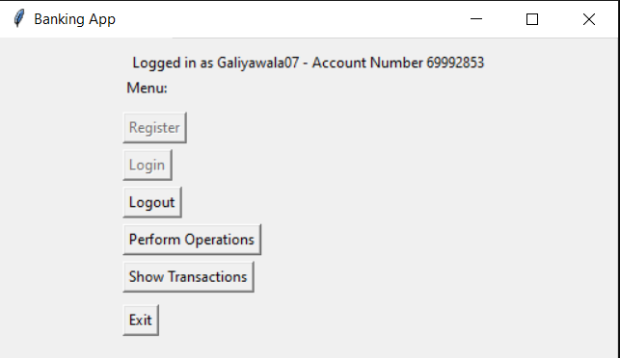
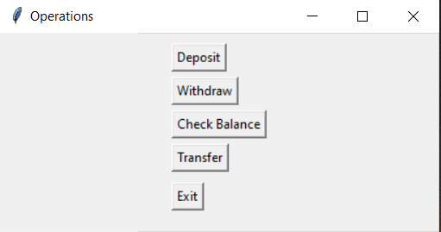
Project DescRiption
Operations after clicking operations button
Home after Login

Slide 9
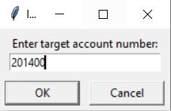
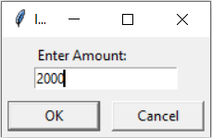
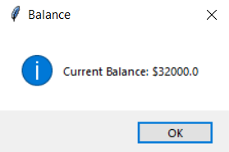
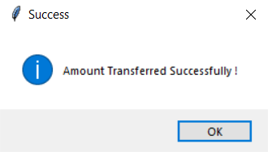
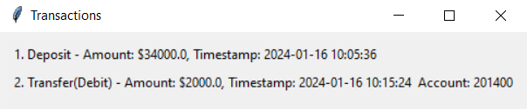
Project DescRiption
Transfer 1
Transfer 2
Check Balance
Transfer 3
Transaction window

Slide 10
SUMMARY
So, this project offers secure and user-friendly platform for seamless financial transactions. With secure authentication and efficient operation management.

Slide 11
THANK YOU
Gaurav Galiyawala
Gaurav.Galiyawala@amdocs.com

